Slide 1
Azure data explorer
Let’s grow 16-11-2022

Slide 2
What is Azure Data Explorer?
Azure Data Explorer is a fully managed, high-performance, big data analytics platform that makes it easy to analyze high volumes of data in near real time. The Azure Data Explorer toolbox gives you an end-to-end solution for data ingestion, query, visualization, and management.
By analyzing structured, semi-structured, and unstructured data across time series, and by using Machine Learning, Azure Data Explorer makes it simple to extract key insights, spot patterns and trends, and create forecasting models. Azure Data Explorer is scalable, secure, robust, and enterprise-ready, and is useful for log analytics, time series analytics, IoT, and general-purpose exploratory analytics.
Azure Data Explorer capabilities are extended by other services built on its powerful query language, including Azure Monitor logs, Application Insights, Time Series Insights, and Microsoft Defender for Endpoint.

Slide 3
When should you use Azure Data Explorer?
Use the following questions to help decide if Azure Data Explorer is right for your use case:
Interactive analytics: Is interactive analysis part of the solution? For example, aggregation, correlation, or anomaly detection.
Variety, Velocity, Volume: Is your schema diverse? Do you need to ingest massive amounts of data in near real-time?
Data organization: Do you want to analyze raw data? For example, not fully curated star schema.
Query concurrency: Will multiple users or processes use Azure Data Explorer?
Build vs Buy: Do you plan on customizing your data platform?

Slide 4
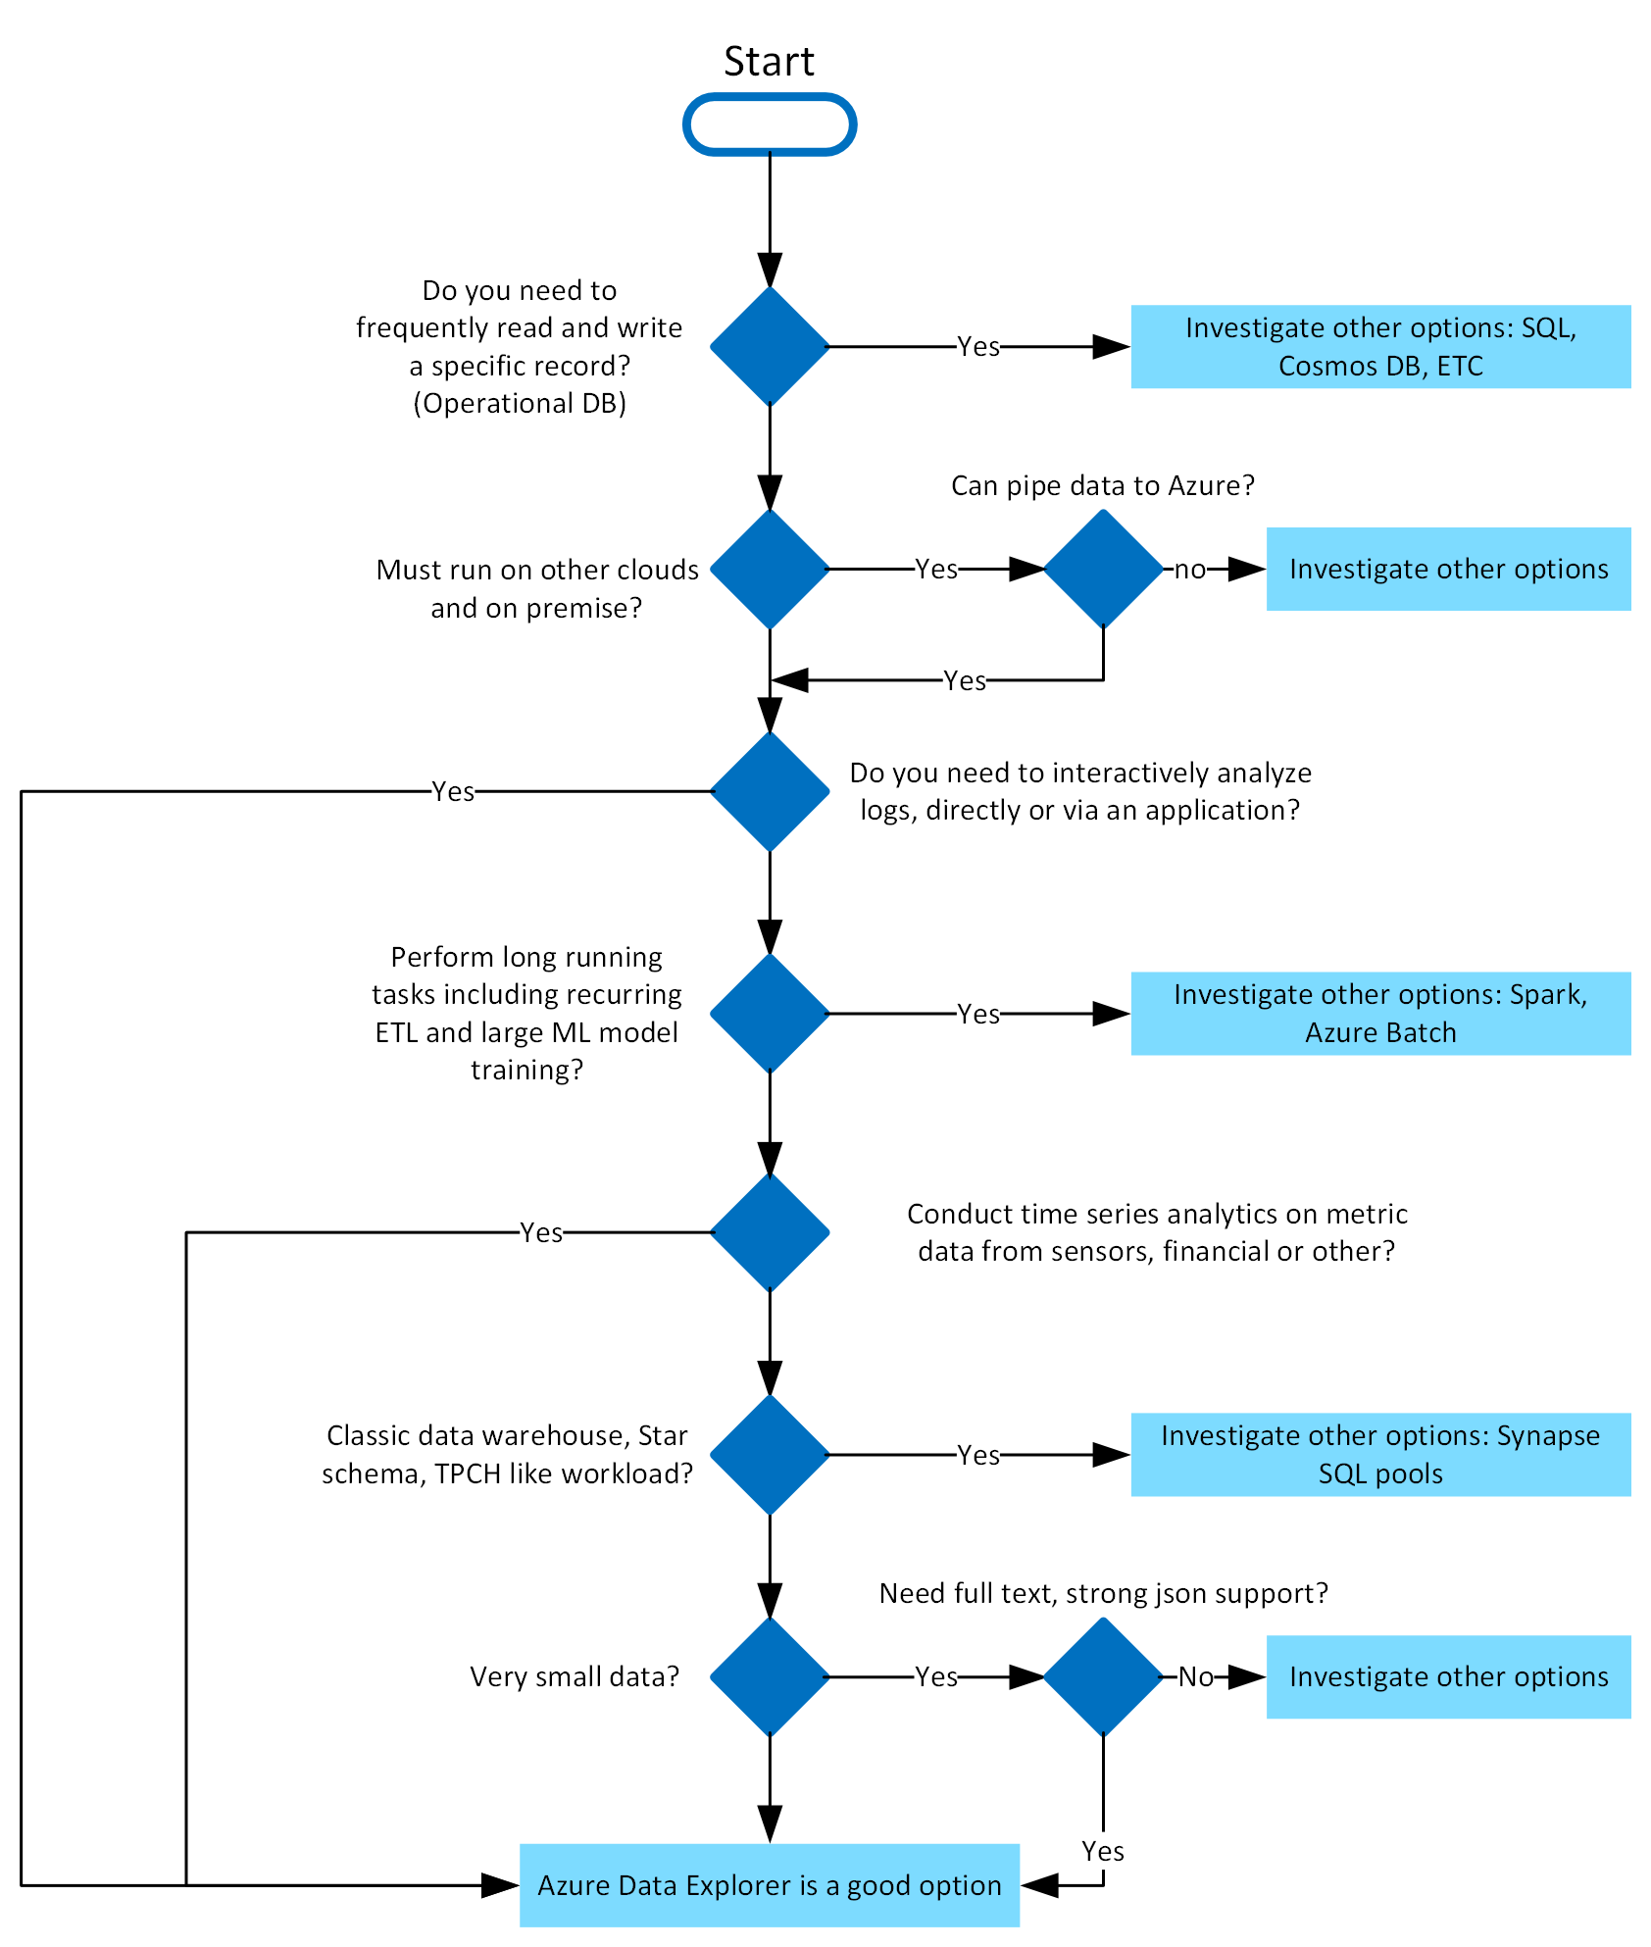

Slide 5
What makes Azure Data Explorer unique?
Data velocity, variety, and volume
With Azure Data Explorer, you can ingest terabytes of data in minutes in batch or streaming mode. You can query petabytes of data, with results returned within milliseconds to seconds. Azure Data Explorer provides high velocity (millions of events per second), low latency (seconds), and linear scale ingestion of raw data. Ingest your data in different formats and structures, flowing from various pipelines and sources.
User-friendly query language
Query Azure Data Explorer with the Kusto Query Language (KQL), an open-source language initially invented by the team. The language is simple to understand and learn, and highly productive. You can use simple operators and advanced analytics.

Slide 6
What makes Azure Data Explorer unique?
Advanced analytics
Use Azure Data Explorer for time series analysis with a large set of functions including: adding and subtracting time series, filtering, regression, seasonality detection, geospatial analysis, anomaly detection, scanning, and forecasting. Time series functions are optimized for processing thousands of time series in seconds. Pattern detection is made easy with cluster plugins that can diagnose anomalies and do root cause analysis. You can also extend Azure Data Explorer capabilities by embedding python code in KQL queries.
Easy-to-use wizard
The ingestion wizard makes the data ingestion process easy, fast, and intuitive. The Azure Data Explorer web UI provides an intuitive and guided experience that helps you ramp-up quickly to start ingesting data, creating database tables, and mapping structures. It enables one time or a continuous ingestion from various sources and in various data formats. Table mappings and schema are auto suggested and easy to modify.

Slide 7
What makes Azure Data Explorer unique?
Versatile data visualization
Data visualization helps you gain important insights. Azure Data Explorer offers built-in visualization and dashboarding out of the box, with support for various charts and visualizations. It has native integration with Power BI, native connectors for Grafana, Kibana and Databricks, ODBC support for Tableau, Sisense, Qlik, and more.
Automatic ingest, process, and export
Azure Data Explorer supports server-side stored functions, continuous ingest, and continuous export to Azure Data Lake store. It also supports ingestion time-mapping transformations on the server side, update policies, and precomputed scheduled aggregates with materialized views.

Slide 8
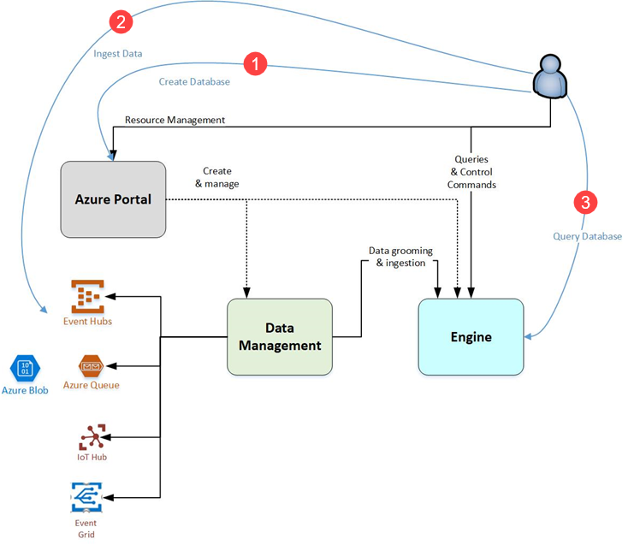
Azure Data Explorer flow

Slide 9
Azure Data Explorer flow
Create database: Create a cluster and then create one or more databases in that cluster. Each Azure Data Explorer cluster can hold up to 10,000 databases and each database up to 10,000 tables. The data in each table is stored in data shards also called “extents”. All data is automatically indexed and partitioned based on the ingestion time. This means you can store a lot of varied data and because of the way it's stored, you get fast access to querying it.
Ingest data: Load data into database tables so that you can run queries against it. Azure Data Explorer supports several ingestion methods, each with its own target scenarios. These methods include ingestion tools, connectors and plugins to diverse services, managed pipelines, programmatic ingestion using SDKs, and direct access to ingestion.
Notes:
https://learn.microsoft.com/en-us/azure/data-explorer/create-cluster-database-portal
https://learn.microsoft.com/en-us/azure/data-explorer/ingest-data-wizard
https://learn.microsoft.com/en-us/azure/data-explorer/kusto/query/
https://learn.microsoft.com/en-us/azure/data-explorer/kusto/query/sqlcheatsheet
https://learn.microsoft.com/en-us/azure/data-explorer/web-query-data

Slide 10
Azure Data Explorer flow
Query database: Azure Data Explorer uses the Kusto Query Language, which is an expressive, intuitive, and highly productive query language. It offers a smooth transition from simple one-liners to complex data processing scripts, and supports querying structured, semi-structured, and unstructured (text search) data. There's a wide variety of query language operators and functions (aggregation, filtering, time series functions, geospatial functions, joins, unions, and more) in the language. KQL supports cross-cluster and cross-database queries, and is feature rich from a parsing (json, XML, and more) perspective. The language also natively supports advanced analytics. Use the web application to run, review, and share queries and results. You can also send queries programmatically (using an SDK) or to a REST API endpoint.
Visualize results: Use different visual displays of your data in the native Azure Data Explorer Dashboards. You can also display your results using connectors to some of the leading visualization services, such as Power BI and Grafana. Azure Data Explorer also has ODBC and JDBC connector support to tools such as Tableau and Sisense.

Slide 11
What's in an Azure Data Explorer cluster?
Each Azure Data Explorer cluster can hold up to 10,000 databases and each database up to 10,000 tables. The data in each table is stored in data shards also called "extents". All data is automatically indexed and partitioned based on the ingestion time. Unlike a relational database, there are no primary foreign key constraints or any other constraints, such as uniqueness. This means you can store a lot of varied data and because of the way it's stored, you get fast access to querying it.
The logical structure of a database is similar to many other relational databases. An Azure Data Explorer database can contain:
Tables: Made up of a set of columns. Each column has one of nine different data types.
External tables: Tables whose underlying storage is in other locations such as Azure Data Lake.

Slide 12
What is a free Azure Data Explorer cluster?
Free cluster allows anyone with a Microsoft account or an Azure Active Directory user identity to create a free Azure Data Explorer cluster without needing an Azure subscription or a credit card.
It's a frictionless way to create a free cluster that can be used for any purpose. It's the ideal solution for anyone who wants to get started quickly with Azure Data Explorer and experience the incredible engine performance and enjoy the productive Kusto Query Language.
The cluster's trial period is for a year and may automatically be extended. The cluster is provided as-is and isn't subject to the Azure Data Explorer service level agreement. At any time, you can upgrade the cluster to a full Azure Data Explorer cluster.
Notes:
https://aka.ms/kustofree

Slide 13
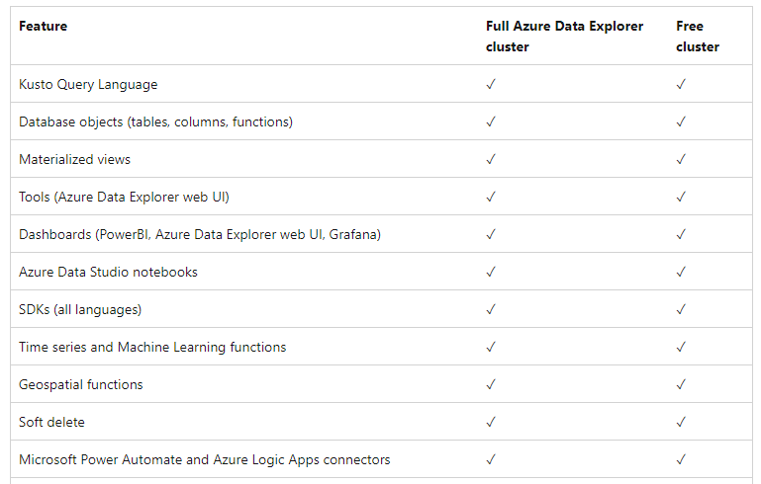
Free cluster features

Slide 14
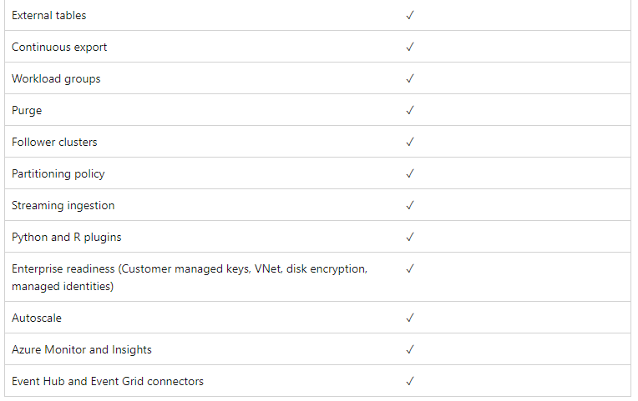
Full cluster features

Slide 15
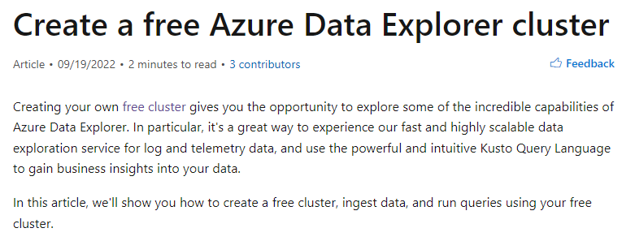
Free azure data explorer cluster
https://learn.microsoft.com/en-us/azure/data-explorer/start-for-free-web-ui

Slide 16
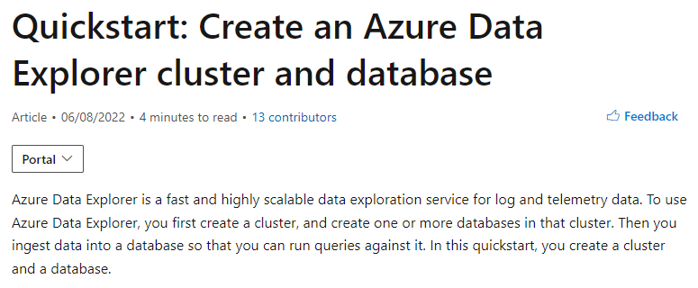
Quickstart azure data explorer
https://learn.microsoft.com/en-us/azure/data-explorer/create-cluster-database-portal

Slide 17
How do I get my data into Azure Data Explorer?
Data ingestion is the process used to load data records from one or more sources into a table in Azure Data Explorer. Further data manipulation includes matching schema, organizing, indexing, encoding, and compressing the data. The Data Manager then commits the data ingest to the engine, where it's available for query.
There are a variety of ingestion tools available in addition to the native Web UI wizard, such as managed pipelines — Event Grid, IoT Hub, and Azure Data Factory. You can use connectors and plugins such as the Logstash plugin, Kafka connector, Power Automate, and Apache Spark connector. You can also use programmatic ingestion using SDKs, or LightIngest.
Data can be ingested in two modes: Batching or Streaming. Batching ingestion is optimized for high ingestion throughput and fast query results. Streaming ingestion allows near real-time latency for small sets of data per table.

Slide 18
Azure Data Explorer data ingestion overview
Data ingestion is the process used to load data records from one or more sources into a table in Azure Data Explorer. Once ingested, the data becomes available for query.
The diagram below shows the end-to-end flow for working in Azure Data Explorer and shows different ingestion methods.

Slide 19
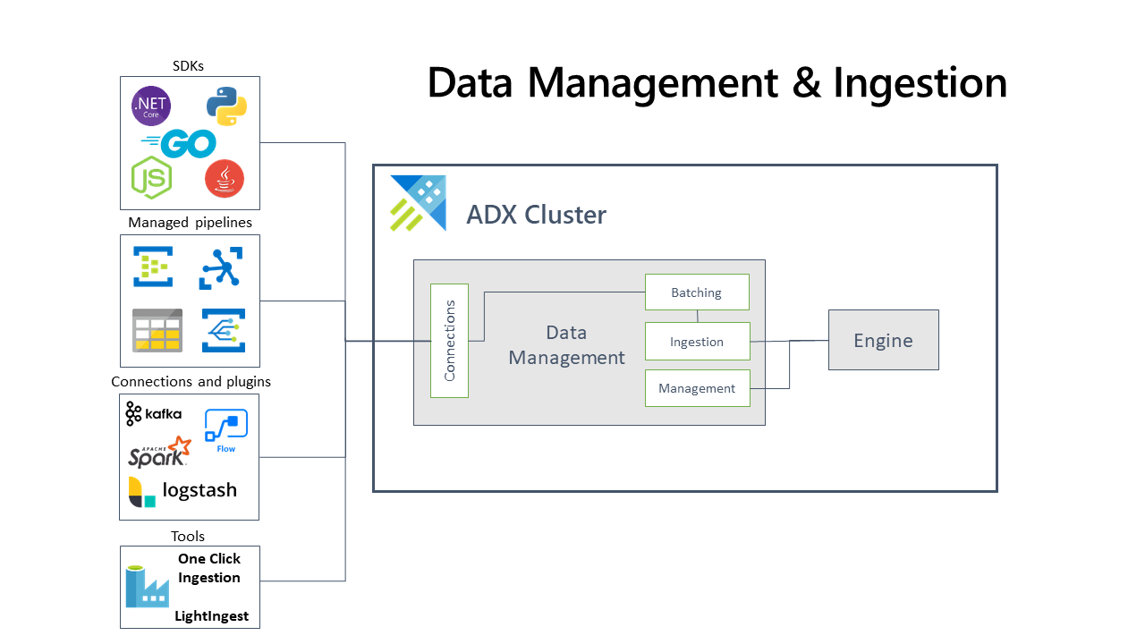

Slide 20
ingestion
The Azure Data Explorer data management service, which is responsible for data ingestion, implements the following process:
Azure Data Explorer pulls data from an external source and reads requests from a pending Azure queue. Data is batched or streamed to the Data Manager. Batch data flowing to the same database and table is optimized for ingestion throughput. Azure Data Explorer validates initial data and converts data formats where necessary. Further data manipulation includes matching schema, organizing, indexing, encoding, and compressing the data. Data is persisted in storage according to the set retention policy. The Data Manager then commits the data ingest into the engine, where it's available for query.

Slide 21
ingestion
https://learn.microsoft.com/en-us/azure/data-explorer/ingest-data-overview

Slide 22
How do I analyze my data?
Azure Data Explorer uses the proprietary Kusto Query Language (KQL) to analyze data. It's widely used in Microsoft (Azure Monitor - Log Analytics and Application Insights, Microsoft Sentinel, and Microsoft 365 Defender). KQL is optimized for fast-flowing, diverse, big data exploration. Queries reference tables, views, functions, and any other tabular expressions. This can include tables in different databases or even clusters. Queries can be run using the Web UI, a variety of query tools, or with one of the Azure Data Explorer SDKs.

Slide 23
How does the Kusto Query Language work?
Kusto Query Language is an expressive, intuitive, and highly productive query language. It offers a smooth transition from simple one-liners to complex data processing scripts, and supports querying structured, semi-structured, and unstructured (text search) data. There is a wide variety of query language operators and functions (aggregation, filtering, time series functions, geospatial functions, joins, unions, and more) in the language. KQL supports cross-cluster and cross-database queries, and is feature rich from a parsing (json, XML etc.) perspective. In addition, the language natively supports advanced analytics.

Slide 24
Example scenario
Suppose you're a data analyst with a passion for meteorological data. You want to use KQL to explore a dataset for answers to basic questions about the kinds and locations of storms in the United States.
What will we be doing?
You'll write simple queries in KQL to explore and gain insights from a sample dataset. You'll learn how to:
Count the number of records by using the count operator.
Return a specific number or rows by using the take operator.
Select columns to return by using the project operator.
Filter data by using the where operator.
Reorder returned data by using the sort operator.
Build queries by using multiple operators.

Slide 25
basics
Organizations in all sectors deal with a constant flow of data and need to turn this data into meaningful, actionable insights. In the meteorological scenario, you've obtained a dataset with storm data from the US. In this unit, you'll learn about the basic structure of the Kusto Query Language (KQL) so that you can use it to analyze and interpret this dataset.
What is a Kusto query?
A Kusto query is a read-only request to process data and return results. The request is stated in plain text that's easy to read, author, and automate. A Kusto query has one or more query statements and returns data in a tabular or graph format.

Slide 26
What is a tabular statement?
The most common kind of query statement is a tabular expression statement. Both its input and its output consist of tables or tabular datasets.
Tabular statements contain zero or more operators. Each operator starts with a tabular input and returns a tabular output. Operators are sequenced by a pipe (|). Data flows, or is piped, from one operator to the next. The data is filtered or manipulated at each step and then fed into the following step.
It's like a funnel, where you start out with an entire data table. Each time the data passes through another operator, it's filtered, rearranged, or summarized. Because the piping of information from one operator to another is sequential, the query's operator order is important. At the end of the funnel, you're left with a refined output.

Slide 27
What is a tabular statement?
These operators are KQL-specific, although they often have parallels to SQL or other languages.
StormEvents
| where StartTime between (datetime(2007-11-01) .. datetime(2007-12-01))
| where State == "FLORIDA"
| count
This query has a single tabular expression statement. The statement begins with a reference to a table called StormEvents and contains the operators where and count. Each operator is separated by a pipe. The data rows for the source table are filtered by the value of the StartTime column and then filtered by the value of the State column. In the last line, the query returns a table with a single column and a single row that contains the count of the remaining rows.

Slide 28
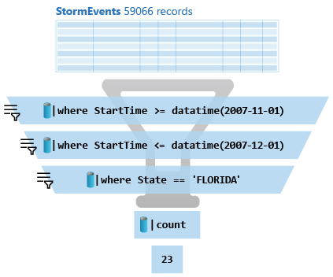
Schematic representation

Slide 29
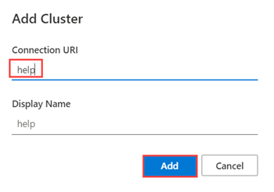
Connect to the data
You'll use the Azure Data Explorer web interface to connect to the data. However, the Kusto Query Language itself can also be used in Log Analytics, Azure Sentinel, and other services. You'll only need to connect once, and you'll continue to use this data connection for all queries in the following units.
Use your Azure account to sign in to the Azure Data Explorer web UI.
In the left pane, select Query.
Select the Add Cluster button at the top of the tab.
In the dialog box, under Connection URI, enter help.
Select Add.

Slide 30
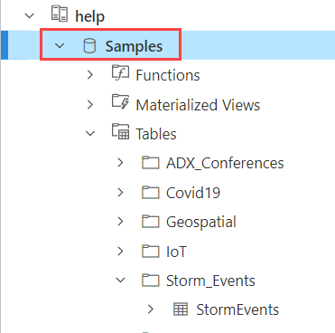
Select the database
Queries always run in the context of a database, so you need to connect to a specific database.
Expand the help cluster in the left pane.
Select the Samples database to give your queries the correct context.
If you expand the Samples database, Tables, and the Storm_Events folder, you'll see a list of tables below the database; we'll be using the StormEvents table.

Slide 31
Return a specific number of rows by using the take operator
Let's look at a sample of the data so you can get to know the columns and types of data in the table. You don't need to see all rows, just a few examples.
The take operator is perfect for this task, because it returns a specific number of arbitrary rows.

Slide 32
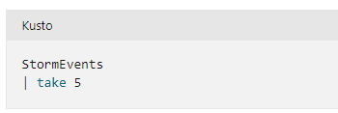
Take
Copy this query to your clipboard:
Paste the query into the query editor that you set up earlier.
Notice that the query begins with a reference to the data table, StormEvents. This data is piped into the first and only operator, which then selects five arbitrary rows.
Run the query by either selecting the Run button above the query window or selecting Shift+Enter on the keyboard.
Check that your results are similar to the following example. The actual data in the rows might differ because the rows are selected arbitrarily.

Slide 33
Use the project operator
Run the following query. This query names the columns to return, and their order, within the project operator.
StormEvents
| project EventType, State, DamageProperty, DamageCrops, InjuriesDirect, InjuriesIndirect
| take 10

Slide 34
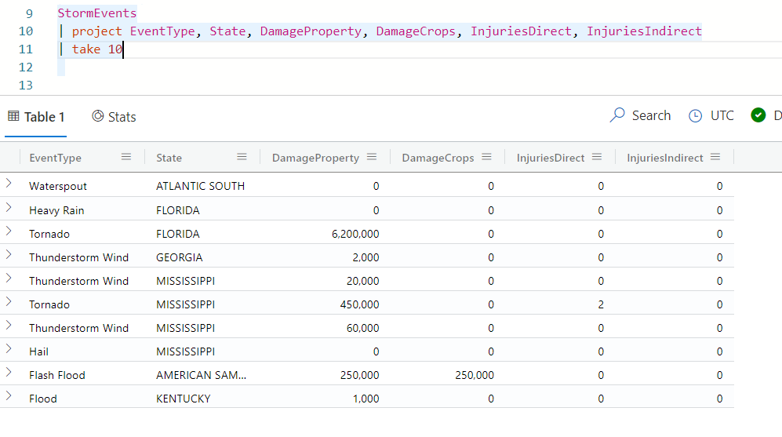
Use the project operator
You should get results that look like the following image:

Slide 35
Rename and define new columns by using project
Update your previous query to make a new column that shows the sum of InjuriesDirect and InjuriesIndirect:
Do the same for the two types of damage columns by adding together damage to crops and damage to property:
Hover over the column name in the query editor to see the data type contained in the columns. You can use a numerical operator to add the values because these columns are of type int (integer).

Slide 36
Rename and define new columns by using project
Rename the State column to US_State:
Review your updated query and run it. The full query includes calculations for injuries, calculations for damages, and renaming the State column.
StormEvents
| project US_State=State, EventType, Injuries=InjuriesDirect+InjuriesIndirect, Damage=DamageCrops+DamageProperty
| take 10

Slide 37
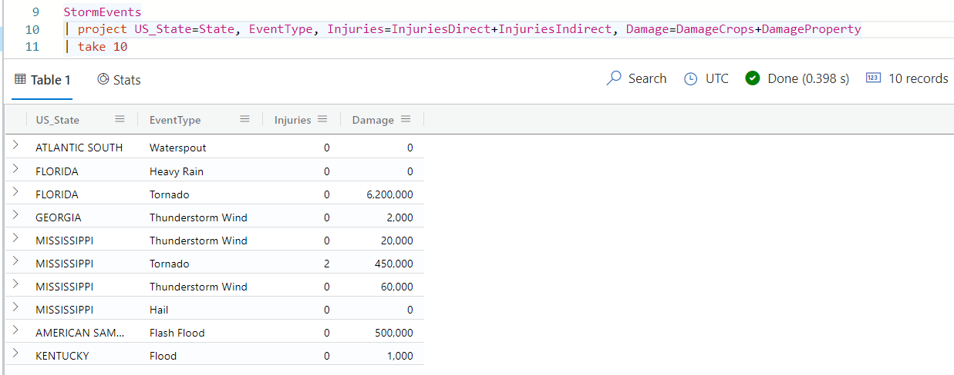
Rename and define new columns by using project
You should get results that look like the following image:

Slide 38
Use the project-away operator
What if you want to remove a few select columns? For this exploration, you don't have any use for the IDs assigned to each episode and event. You can remove specific columns by using the project-away operator, which indicates which columns to remove, while leaving all remaining columns. You can also use a wildcard, such as | project-away *Id, to remove all columns that end in Id.
StormEvents
| project-away EpisodeId, EventId
| take 10
Check your results. Recall that the EpisodeId and EventId columns were between the EndTime and State columns. Which of these columns do you see in the output?

Slide 39
Filter data by using the where operator
Up to this point, all the operators you've used have returned selected columns. Now, let's take a look at specific rows of the data.
The where operator filters results that satisfy a certain condition. In this first example, you'll compare an integer column to a minimum value by using the numerical operator greater than (>). Specifically, you only want to see storms that damaged property. So you'll look at rows of data where the damage to property is greater than zero.
StormEvents
| where DamageProperty > 0
| project State, EventType, DamageProperty
| take 10

Slide 40
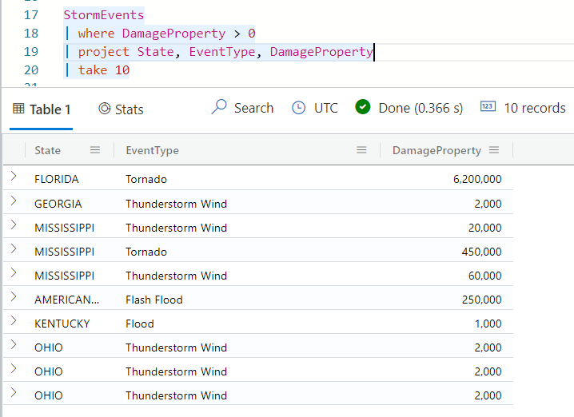
Filter data by using the where operator

Slide 41
Filter data by using the where operator
Similarly, you can filter where the time of an event occurred more than a certain number of days ago. For example, run the following query, where 365d means 365 days:
StormEvents
| where DamageProperty > 0
| where StartTime > ago(365d)
| project State, EventType, DamageProperty

Slide 42
String filter
It looks like quite a few types of storms have caused damage all over the US. Let's narrow that down to storms that happened in a certain location, like the state of Florida.
StormEvents
| where DamageCrops > 0
| where State == "FLORIDA"
| project State, EventType, DamageCrops

Slide 43
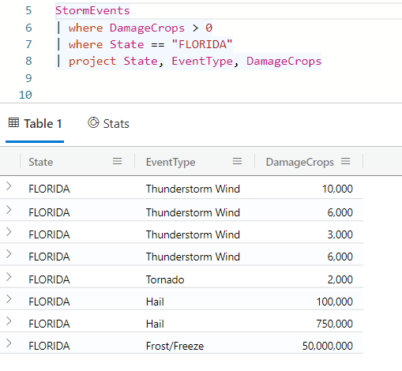
String filter

Slide 44
Filter by using the has operator
One of the event types in the results of the last query is called Thunderstorm Wind. Let's see if there are any other kinds of wind that caused property damage in Florida. We'll search on a string match of wind by using the has operator. The has operator is a case-insensitive search that matches on a full term.
StormEvents
| where DamageProperty > 0
| where State == "FLORIDA"
| where EventType has "wind"
| project StartTime, EventType, DamageProperty

Slide 45
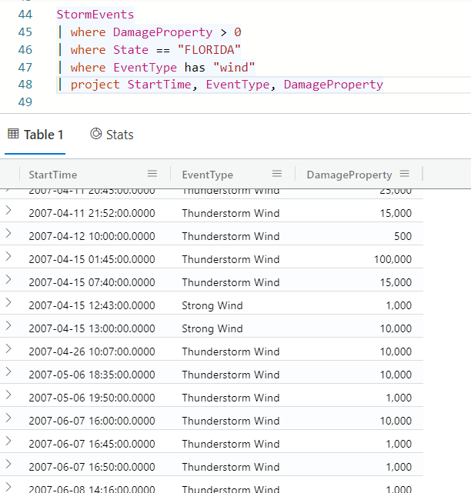
Has operator

Slide 46
Contains operator
The contains operator is similar to has, but it matches on any substring. For example, the following query will return results such as Freezing fog and Frost/Freeze.
StormEvents | where EventType contains "free“
The has operator is more performant than the contains operator, so use has wherever you have a choice between the two.

Slide 47
Filter on datetime values
Let's look more closely at the damage done in the first half of the calendar year. It can be useful to limit your search to events within a specific time range. Some interfaces with Kusto Query Language have a dropdown time picker, but others require you to incorporate the date filter into the query itself.
Because time ranges are bounded by two extremes, it's most efficient to construct a query where you choose a value that's between these two times.
The syntax for constructing this date range is as follows:
where time between (datetime(value)..datetime(value))

Slide 48
Filter on datetime values
Let's incorporate this datetime range into a kind of query you've already seen. Run the following query:
StormEvents
| where StartTime between (datetime(2007-01-01)..datetime(2007-06-01))
| where DamageProperty > 0
| where State == "FLORIDA"
| project StartTime, EventType, DamageProperty
| take 50

Slide 49
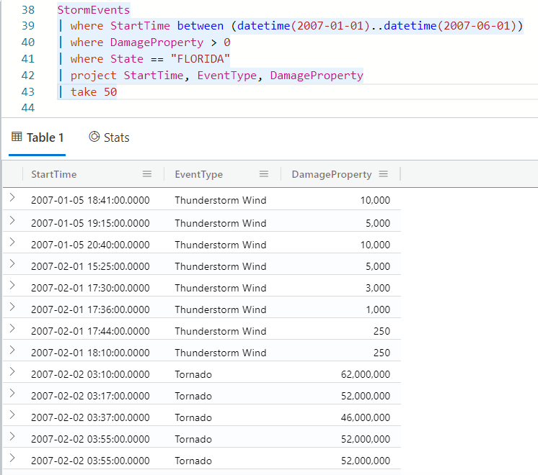
Filter on datetime values

Slide 50
Use the sort operator
It's difficult to make sense of unordered data. Let's make it a bit easier to understand by organizing the order in which the results are presented. You want to know which events caused the highest damage to property, so you'll order the results by the field DamageProperty.
StormEvents
| where DamageProperty > 0
| project State, EventType, DamageProperty
| sort by DamageProperty desc

Slide 51
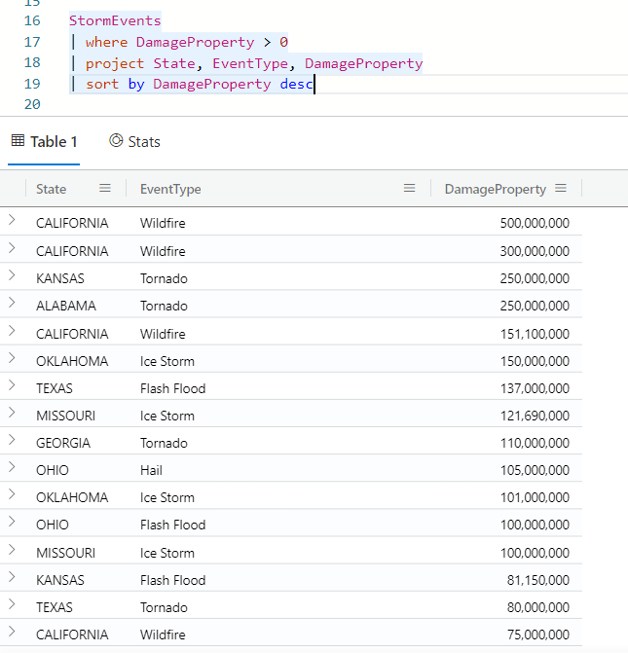
Use the sort operator

Slide 52
Sort on more than one expression
Each region has unique weather patterns, so now you want to know which events in each state made the most damage. To answer this question, you'll sort first on the state name and then on the damage within each state. The sort operator sorts in descending order by default, so you'll use asc to indicate that you want to sort the state names in ascending order.
StormEvents
| where DamageProperty > 0
| project State, EventType, DamageProperty
| sort by State asc, DamageProperty

Slide 53
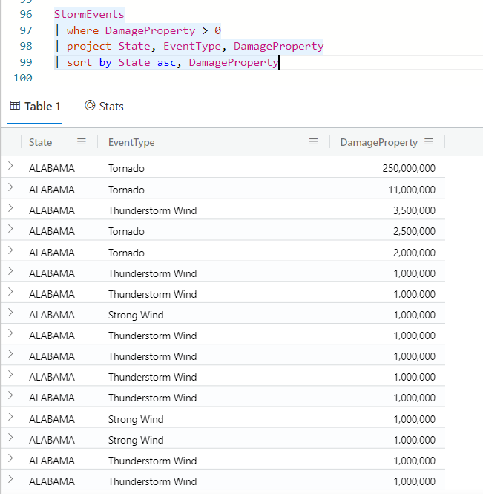

Slide 54
Use the top operator
Instead of sorting and scanning the top for a certain number of results, you can use the top operator to show the a specific number of top results. In fact, the top operator is more performant, so it's the preferred choice when you just want a certain number of top results.
StormEvents
| where State == "FLORIDA"
| top 10 by DamageProperty
| project State, EventType, DamageProperty

Slide 55
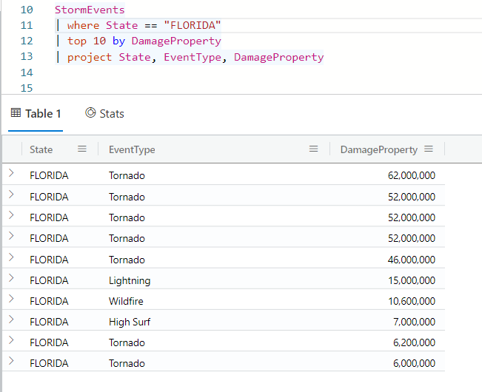
Use the top operator

Slide 56
exercise
Recall that in the storm events example, you've narrowed down events by time range, keywords, and values in a particular column. You've also sorted results and projected specific columns.
Now, try writing a query from scratch. Use the StormEvents table to answer the following question:
In the month of April 2007, what were the top five damage-causing storm types in the state of Virginia? In this case, "damage" refers to both property and crop damage.
Use the operators where, project, and top.

Slide 57
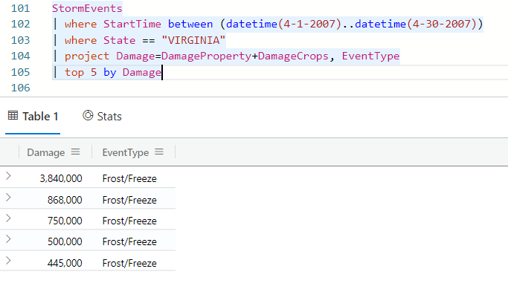
solution

Slide 58
Group data using aggregate functions
Organizations in all sectors deal with a constant flow of data and need to turn this data into meaningful, actionable insights. In the meteorological scenario, you've obtained a dataset with storm data from the US. You've seen in a previous module how to construct basic queries to explore the data.
In this unit, you'll learn about comparing groups of data and presenting the results visually by using the Kusto Query Language (KQL).

Slide 59
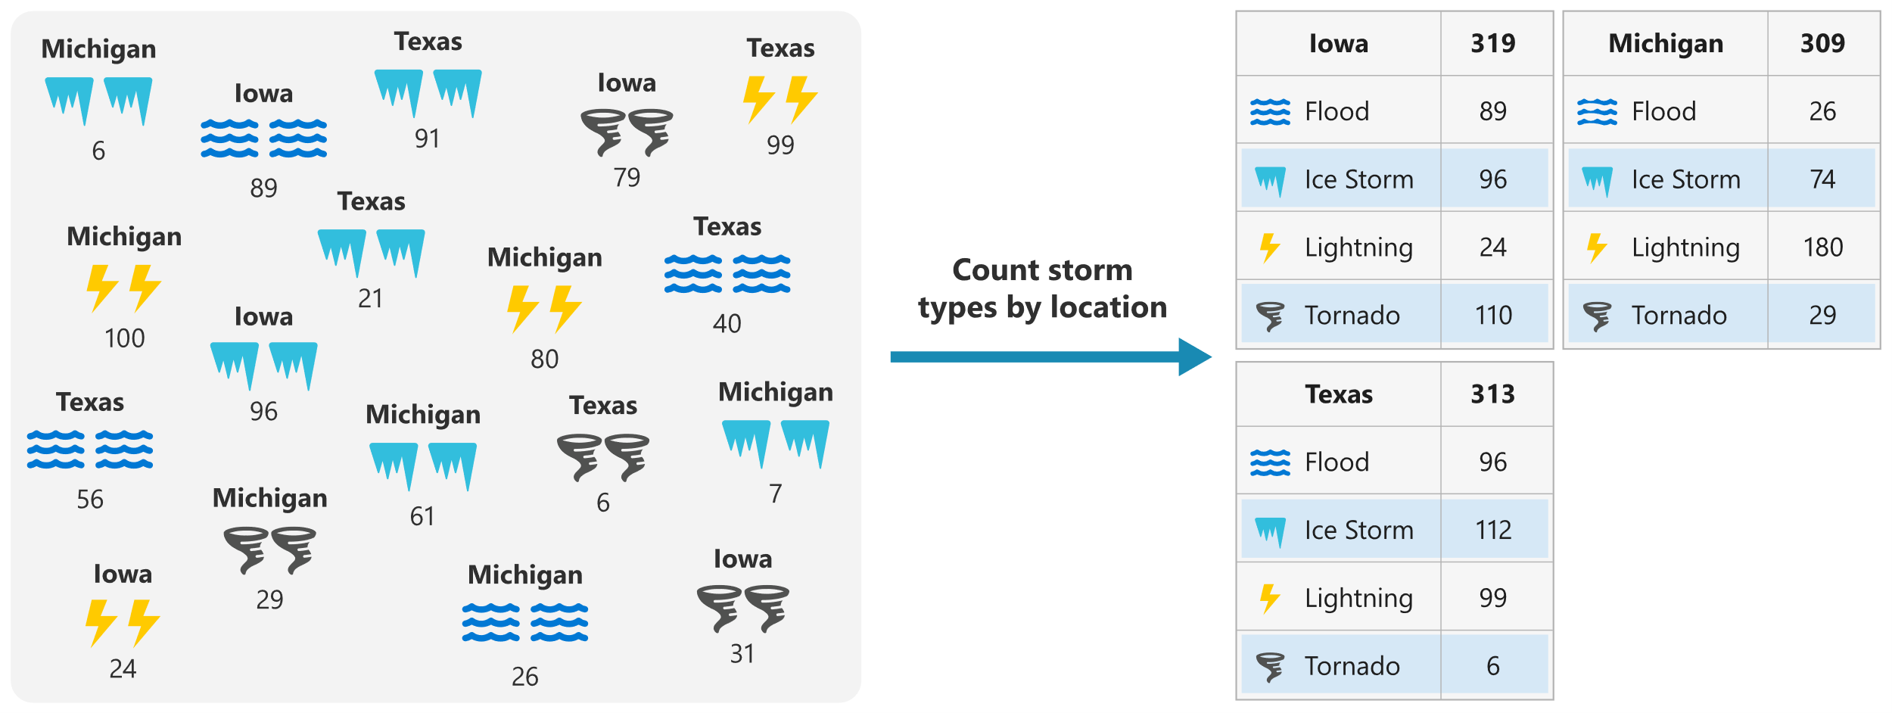
Compare groups of data

Slide 60
Present the results visually
Once you've grouped your data, you'll want to get insights from the results. The default output for queries is tabular. However, in many scenarios, graphical representations can better communicate the results. We'll explore some of the ways to convert Kusto query results to graphical visualizations using the render operator.
Some available types of visualization are linechart, columnchart, barchart, piechart, scatterchart, pivotchart, and others. The following image shows sample Kusto query results rendered as a line chart, column chart, and bar chart.

Slide 61
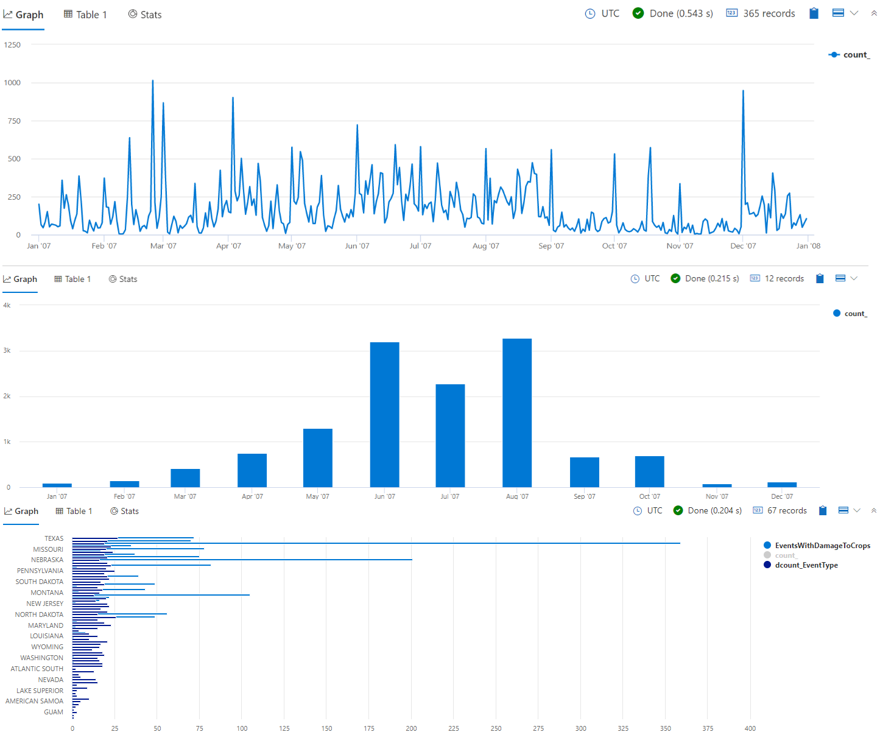

Slide 62
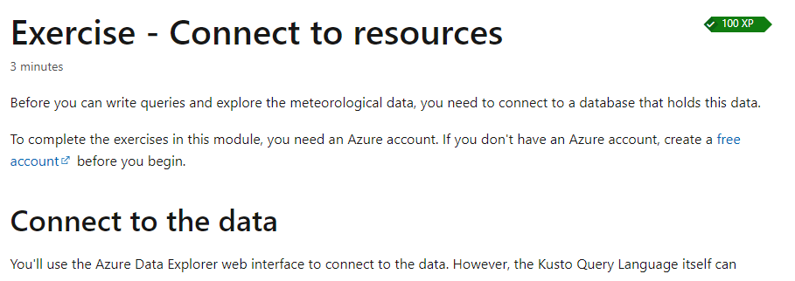
Exercise
https://learn.microsoft.com/en-us/training/modules/gain-insights-data-kusto-query-language/3-exercise-connect-to-resources

Slide 63
recap
COUNT
COUNTIF
DCOUNT
DISTINCT
RENDER
BIN
SUM/AVGAVG
MIN/MAX
PERCENTILES

Slide 64
challenge
Recall that in the storm events, you've used aggregation functions to compare different groups of information. You've organized complex queries with let statements. Finally, you've presented this data in graphical format.
Now it's your turn to try writing a query from scratch.
Use the table we've been exploring up until now, StormEvents, to answer the following question:
What was the total week-by-week damage caused by all flood events? Show damage in the unit of Euros. In this case, damage refers to both property and crop damage. Assume the Euro is worth 1.14 USD.
Use summarize, sum, render, bin, and let.

Slide 65
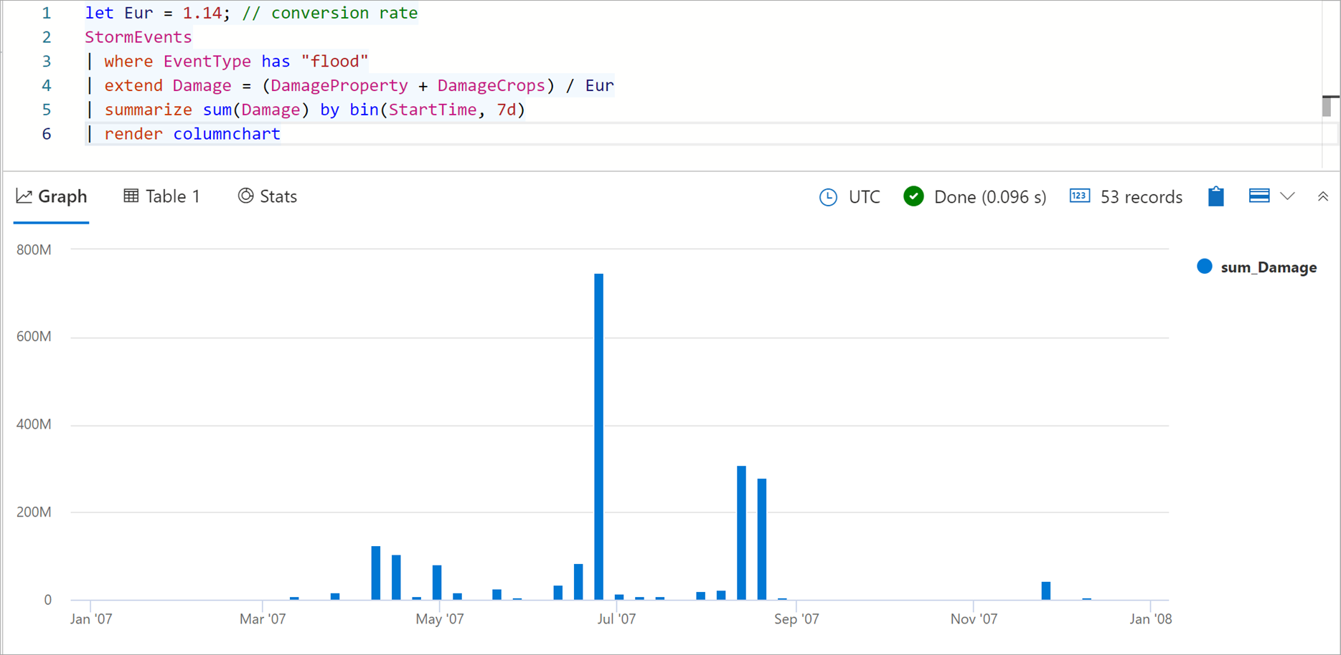
solution

Slide 66
Multi-table queries using Kusto Query Language
Suppose you work at a retail company that sells a wide variety of products. You're the data analyst on the sales team responsible for providing insights that help the team promote awareness of their products and grow sales. You want to provide the desired insights but to do so requires data that's spread across several tables. You'll use KQL to gain the insights by querying data from multiple tables.

Slide 67
Combine and optimize data
Organizations often collate different types of information from many sources. The information is stored in a large number of tables. Occasionally, you may need to join tables based on logical relationships between them, for the purpose of deeper analysis or reporting. In the retail company scenario, you'll use tables for customers, products, and sales information.

Slide 68
Understand your data
Before you start writing queries that combine information from your tables, you'll need to understand your data. When working with Kusto queries, you'll want to think of tables as broadly belonging to one of two categories:
Fact tables: Tables whose records are immutable facts, such as the SalesFact table in the retail company scenario. In these tables, records are progressively appended in a streaming fashion or in large chunks. The records stay there until they're removed and are never updated.
Dimension tables: Tables whose records are mutable dimensions, such as the Customers and Products tables in the retail company scenario. These tables hold reference data, such as lookup tables from an entity identifier to its properties. Dimension tables aren't regularly ingested with new data.
In the retail company scenarios, you'll use the dimension tables to enrich the SalesFact table with additional information or to provide more options for filtering the data for queries.

Slide 69
Understand your data
You'll also want to understand the volumes of data you're working with and its structure, or schema (column names and types). You can run the following queries to get that information replacing TABLE_NAME with name of the table you're examining:
TABLE_NAME
| count
TABLE_NAME
| getschema

Slide 70
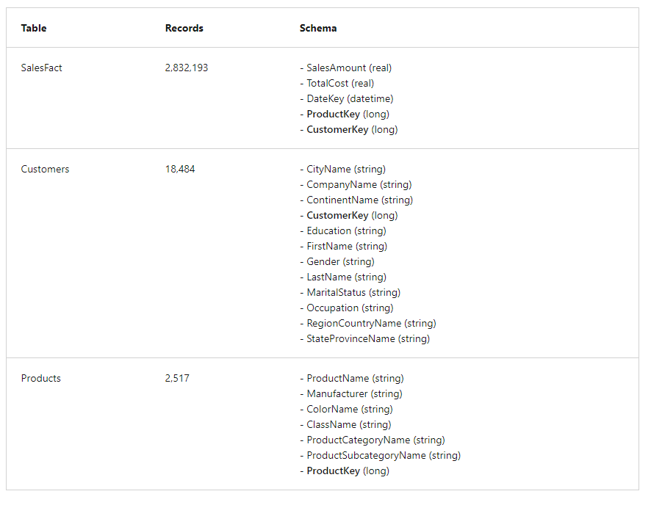

Slide 71
Understand multi-table queries
So you've analyzed your data, now you need to understand how to combine tables to provide the information you need. Kusto queries provide several operators that you can use to combine data from multiple tables, including the lookup, join, and union operators.
The join operator merges the rows of two tables by matching values of the specified columns from each table. The resultant table depends on the kind of join you use. For example, if you use an inner join, the table will have the same columns as the left table (sometimes called the outer table), plus the columns from the right table (sometimes called the inner table). You'll learn more about join kinds in the next section. For best performance, if one table is always smaller than the other, use it as the left side of the join operator.
The lookup operator is a special implementation of join operator that optimizes the performance of queries where a fact table is enriched with data from a dimensions table. It extends the fact table with values looked-up in a dimension table. For best performance, the system by default assumes that the left table is the larger (facts) table, and the right table is the smaller (dimensions) table. This is exactly opposite to the assumption used by the join operator.

Slide 72
Understand multi-table queries
The union operator returns all the rows from two or more tables. It's useful when you want to combine data from multiple tables.
The materialize() function caches results within a query execution for subsequent reuse in the query. It's like taking a snapshot of the results of a sub-query and using it multiple times within the query. This is useful in optimizing queries for scenarios, such as the following, where the results:
Are expensive to compute
Are non-deterministic

Slide 73
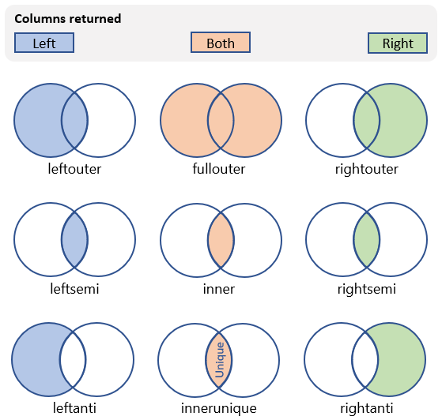
Kinds of join

Slide 74
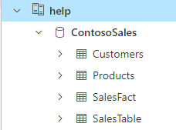
Connect to the data
Queries always run in the context of a database, so you need to connect to a specific database.
Expand the help cluster in the left pane.
Select the ContosoSales database to give your queries the correct context.

Slide 75
Use the join operator
In the retail company scenario, your team starts by asking you for the three countries that have the most sales.
You start by inspecting the SalesFact table and see that the figures you need are available in the SalesAmount column, but the table doesn't contain any country data. Examining the other tables, you notice that the country data is available in the RegionCountryName column in the Customers table. You also notice that both tables have a CustomerKey column.
Since the data is spread over two tables, you'll need to get data from the customer data, and the sales data to be able to write a query that provides the requested information. You can use the join operator to do this, using the CustomerKey to match rows from both tables.

Slide 76
Use the join operator
Run the following query to get 10 matching arbitrary rows from the Customers table and the SalesFact table.
Customers
| join kind=inner SalesFact on CustomerKey
| take 10
Run the following query to summarize the joined tables to get the three countries that have the most sales.
Customers
| join kind=inner SalesFact on CustomerKey
| summarize TotalAmount = round(sum(SalesAmount)) by RegionCountryName
| top 3 by TotalAmount

Slide 77
Use the join operator
You're then asked to answer a similar question to identify countries with lowest revenue in the last recorded year, by month. To do this, you'll use the same query, but this time you'll use the startofmonth function to facilitate grouping by month. You'll also use the arg_min() aggregation function to find the countries with the smallest revenue in each month.
Customers
| join kind=inner SalesFact on CustomerKey
| summarize TotalAmount = round(sum(SalesAmount))
by Month = startofmonth(DateKey), RegionCountryName
| summarize arg_min(TotalAmount, RegionCountryName) by Month
| top 12 by Month desc

Slide 78
exercise
Your sales team wants to know the total sales per product category. You start by reviewing the available data and realize that you'll need the Products table to get the list of product categories and the SalesFact table to get the sales data. You also realize that you'll want to count the sales for each category and list all product categories, even ones that may not have sales.

Slide 79
Use the leftouter join kind
Your sales team wants to know the total sales per product category. You start by reviewing the available data and realize that you'll need the Products table to get the list of product categories and the SalesFact table to get the sales data. You also realize that you'll want to count the sales for each category and list all product categories, even ones that may not have sales.
Products
| join kind=leftouter SalesFact on ProductKey
| summarize TotalSales = count() by ProductCategoryName
| order by TotalSales desc

Slide 80
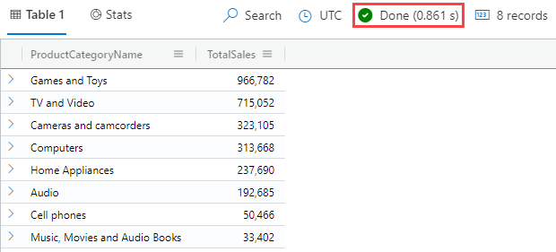
Use the leftouter join kind

Slide 81
Use the rightanti join kind
Similarly, your sales team wants to know the number of products that don't sell in each product category. You can use a right anti join to get all the rows from the Products table that don't match any rows in the SalesFacts table, and then group the results by product category.
SalesFact
| join kind=rightanti Products on ProductKey
| summarize Count = count() by ProductCategoryName
| order by Count desc

Slide 82
Use the lookup operator
Your sales team wants to know total sales per country. You could use a join to get the customer and product information. However, this kind of query performs best when using the lookup operator to get the information you need. Recall that the lookup operator enriches a fact table with data from a dimensions table. It's a bit like reading a book (fact table) and looking up unknown words in a dictionary (dimensions table).
SalesFact
| lookup Customers on CustomerKey
| take 10

Slide 83
Use the lookup operator
In the previous example, you used a left outer join to get the total sales per product category. The query took 0.861 seconds to run. You'll now write a query to get the same result using the lookup operator and compare the execution time.
SalesFact
| lookup Products on ProductKey
| summarize TotalSales = count() by ProductCategoryName
| order by TotalSales desc
Notice that you get the same results but the execution time is 0.398 second. The faster execution time is because the lookup operator is optimized for this type of query.

Slide 84
Use the union operator
Your sales team asks you to create a single table that combines 10 arbitrary sales from each one of the following countries: Australia, United Kingdom, and United States.
You'll use the let statement to create three tabular expressions, each with 10 records from a specific country in the SalesFact table, to represent sales data from three countries. You can think of them as three separate tables.
Examining these tables, you can see that they have the same columns. The only difference is the data in the RegionCountryName column representing the country. You'll' use the union operator to combine the sales facts tables for the United Kingdom and the United States, to the sales facts table for Australia.

Slide 85
let AustraliaSales = SalesFact // Sales facts from Australia
| lookup Customers on CustomerKey
| where RegionCountryName == 'Australia'
| take 10;
let UnitedKingdomSales = SalesFact // Sales facts from United Kingdom
| lookup Customers on CustomerKey
| where RegionCountryName == 'United Kingdom'
| take 10;
let UnitedStatesSales = SalesFact // Sales facts from United States
| lookup Customers on CustomerKey
| where RegionCountryName == 'United States'
| take 10;
AustraliaSales
| union UnitedKingdomSales, UnitedStatesSales

Slide 86
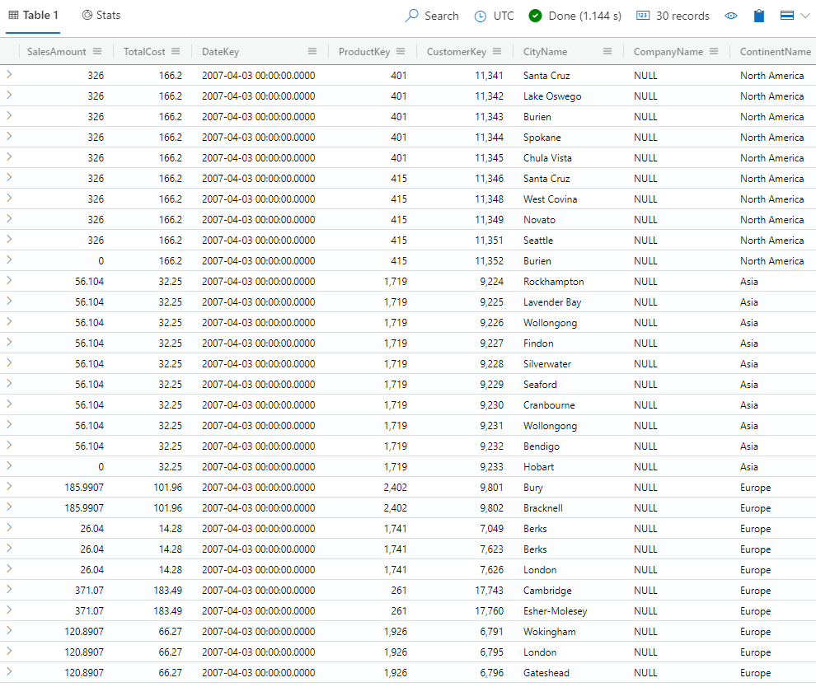

Slide 87
Use the union operator with tables that have different columns
The next month, your sales team again asks you to create the sales data from the three countries. This time when you examined the tables you notice that the tables have different columns. The nice thing about the union operator is that it will combine tables even if they have different columns. For this query, you'll use the alternative syntax for the union operator that doesn't require piped input.

Slide 88
let AustraliaSales = SalesFact
| lookup Customers on CustomerKey
| where RegionCountryName == 'Australia'
| take 10
| project SalesAmount, TotalCost, DateKey, RegionCountryName, CityName;
let UnitedKingdomSales = SalesFact
| lookup Customers on CustomerKey
| where RegionCountryName == 'United Kingdom'
| take 10
| project SalesAmount, TotalCost, DateKey, RegionCountryName, Occupation;
let UnitedStatesSales = SalesFact
| lookup Customers on CustomerKey
| where RegionCountryName == 'United States'
| take 10
| project SalesAmount, TotalCost, DateKey, RegionCountryName, StateProvinceName;
union AustraliaSales, UnitedKingdomSales, UnitedStatesSales

Slide 89
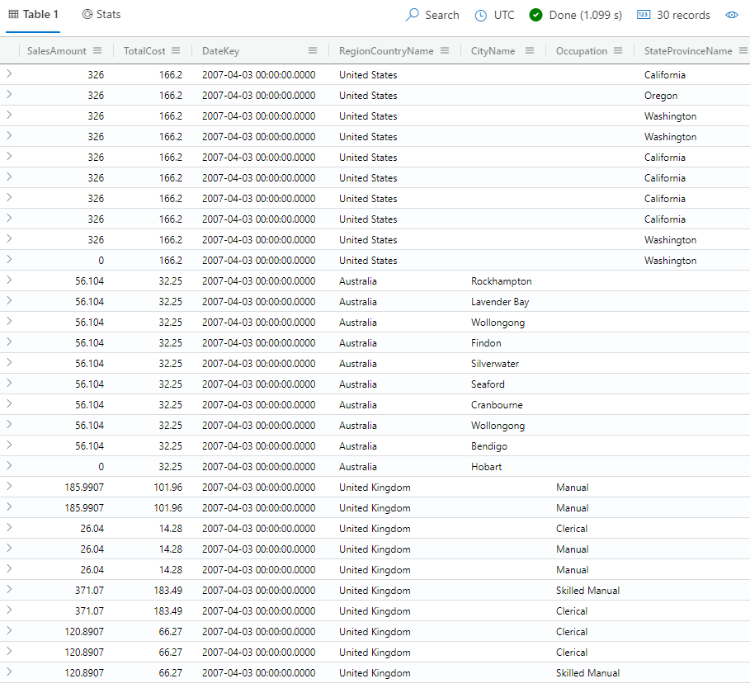

Slide 90
Use the union operator with tables that have different columns and return only the columns that occur in all tables
The following month, your sales team again asks you to create the sales data from the three countries, but this time they only want the columns that are common to all three tables. Previously, you saw that the union operator returns all the columns that occur in any of the tables. This is the default behavior of the union operator, called an outer union, though it's best practice to always explicitly specify the union kind for clarity.
To only return the columns that occur in all tables, you'll use an inner union on the same simulated data by specifying the kind=inner argument, as follows:

Slide 91
let AustraliaSales = SalesFact
| lookup Customers on CustomerKey
| where RegionCountryName == 'Australia'
| take 10
| project SalesAmount, TotalCost, DateKey, RegionCountryName, CityName;
let UnitedKingdomSales = SalesFact
| lookup Customers on CustomerKey
| where RegionCountryName == 'United Kingdom'
| take 10
| project SalesAmount, TotalCost, DateKey, RegionCountryName, Occupation;
let UnitedStatesSales = SalesFact
| lookup Customers on CustomerKey
| where RegionCountryName == 'United States'
| take 10
| project SalesAmount, TotalCost, DateKey, RegionCountryName, StateProvinceName;
union kind=inner AustraliaSales, UnitedKingdomSales, UnitedStatesSales

Slide 93
How can I display my query results?
The Azure Data Explorer Web UI was designed with big data in mind, enabling you to run queries and build dashboards. It supports a display of up to 500 K records and thousands of columns. It's highly scalable and rich with functionality that helps you draw quick insights from your data. You can also use different visual displays of your data in your Azure Data Explorer Dashboards. You can also display your results using native connectors to some of the leading visualization services available today, such as Power BI and Grafana. Azure Data Explorer also has ODBC and JDBC connector support to tools such as Tableau and Qlik.

Slide 94
What are Azure Data Explorer Dashboards?
Dashboards tell a story through visualizations, and are an excellent way to monitor your data and see all of your most important insights at a glance. Dashboards aren't just pictures- they are interactive and the tiles update as the underlying data changes.
The visualizations you see on the dashboard are called tiles. Tiles can display a single number, a graph, a data table, or another visualization. Tiles are dynamically linked to the source data, so they change whenever your underlying data changes. You can pin (create) tiles to a dashboard from a query, or create new tiles within a new or existing dashboard page.

Slide 95
What are the advantages of using the native dashboard experience?
Azure Data Explorer dashboards provide three main advantages:
Explore the data in the Azure Data Explorer web UI. Data is hosted in the Azure Data Explorer product, and can be queried in the same environment you'll use to create dashboards.
Natively pinned queries from the Azure Data Explorer web UI to Azure Data Explorer dashboards. There's no need to export data to another service.
Optimized dashboard rendering performance. Data is dynamically linked to the source, for quick rendering and data update.

Slide 96
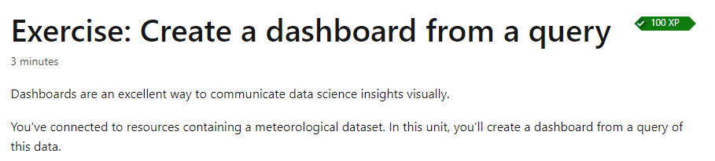
Exercise: dashboards
https://learn.microsoft.com/en-us/training/modules/create-dashboards-azure-data-explorer/4-exercise-create-dashboard-from-query

